Slide 1
Welcome
Prepared By
Rojina Akter
ID: 1244255
Batch: J2EE/CCSL-M/37/01
Email: juitrishadewan@gmail.com
Supervised By
Md. Rajaul Islam

Slide 2
Project Title
Project Management System

Slide 3
Software Requirements Specification (SRS)
Requirements:
We need to build a software for PMS. The application will have following features:
1.There will be company register in the software.
2. A company may have multiple project.
3.A project may have multiple modules, developers, one project manager, multiple team leaders and also project status change system.
4.Every module of each project may have multiple task that will be distributed through developers.
5.Task may have also dependencies if a task has one or more dependency, then dependent task must be completed fast.
6.Best one developer’s activities, they will be rank for yearly increment.
7.There will also will user management system and a user may have multiple roles and user registration will be via email confirmation.

Slide 4
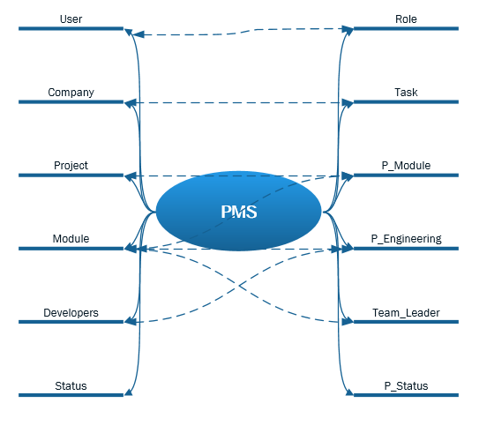
Analysis and Design Part: Brain Storming Diagram:

Slide 5
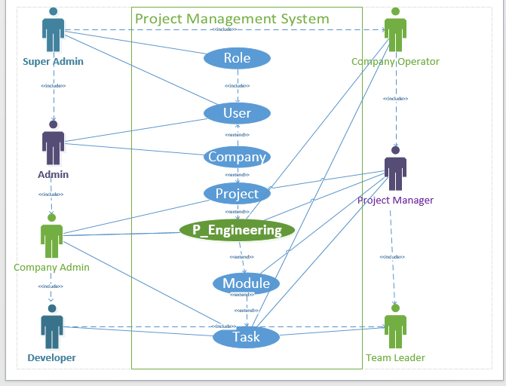
Use Case Diagram:

Slide 6
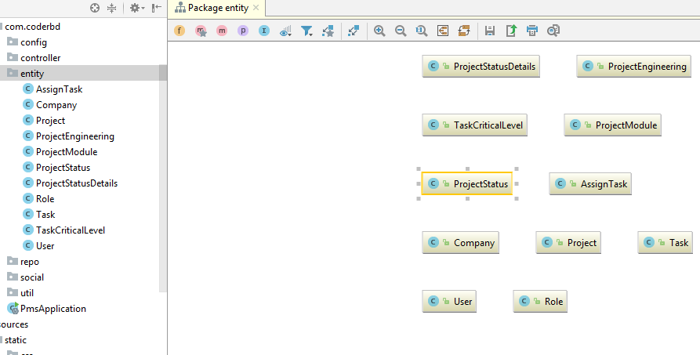
Entity:

Slide 7
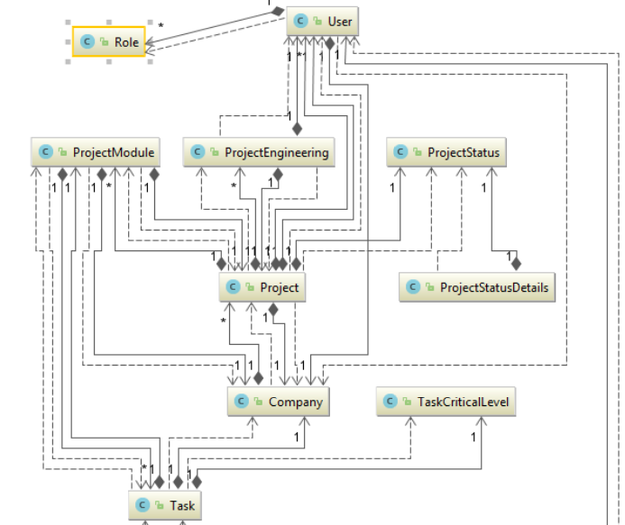
Class Diagram:

Slide 8
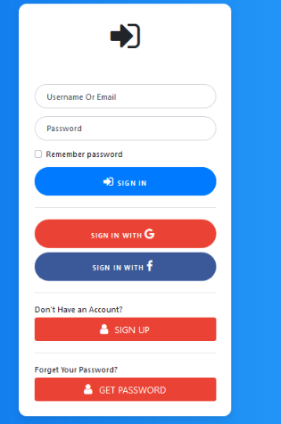
Login Page

Slide 9
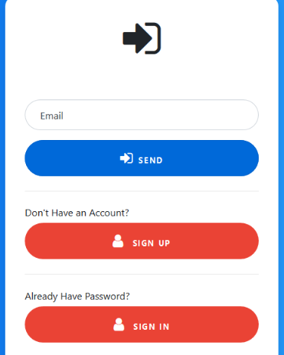
Forget Password

Slide 10
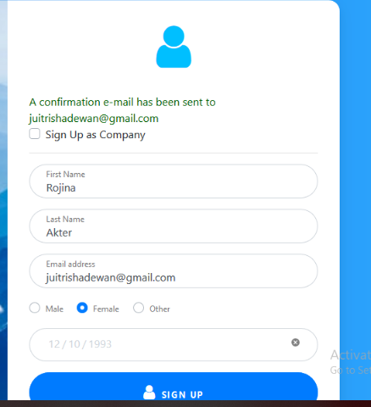
Register

Slide 11
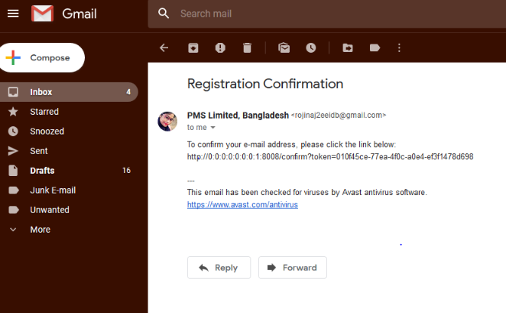
Email_Successful

Slide 12
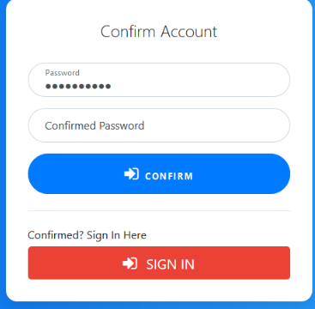
Confirm A/C

Slide 13
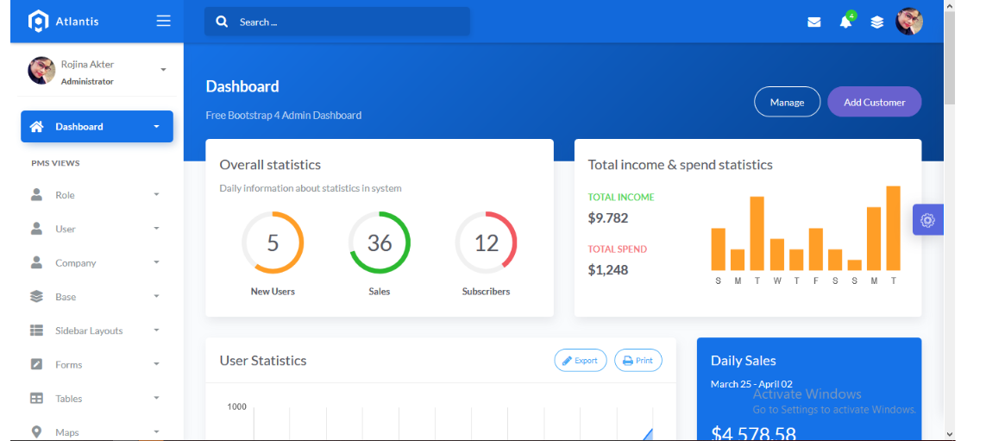
Dashboard

Slide 14
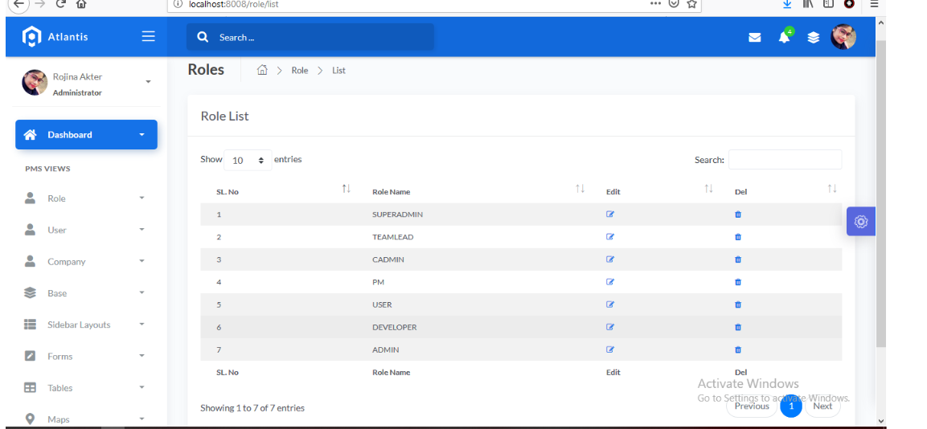
Role List

Slide 15
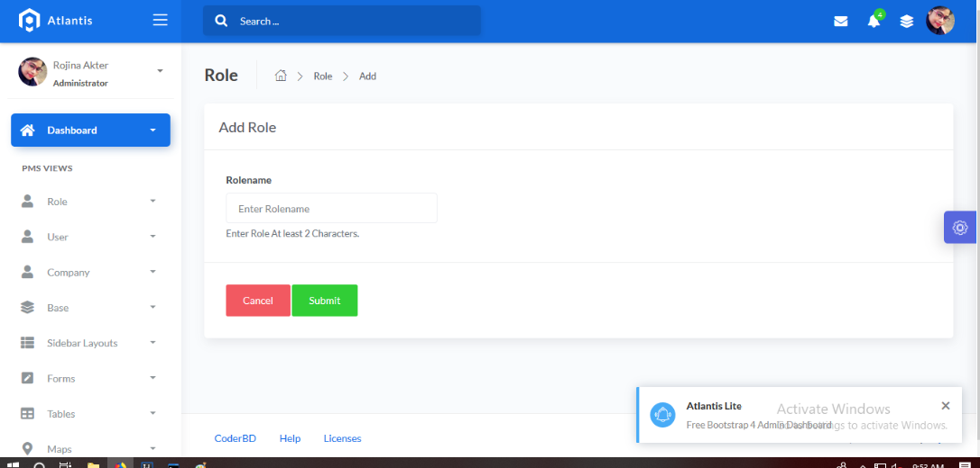
Role Add

Slide 16
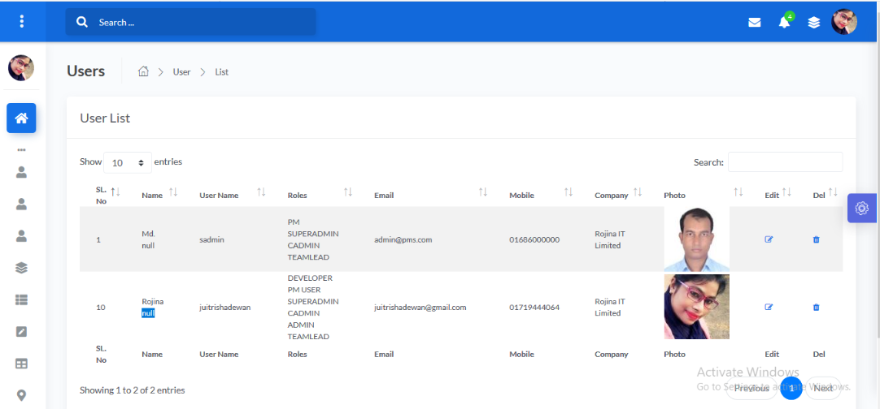
User List

Slide 17
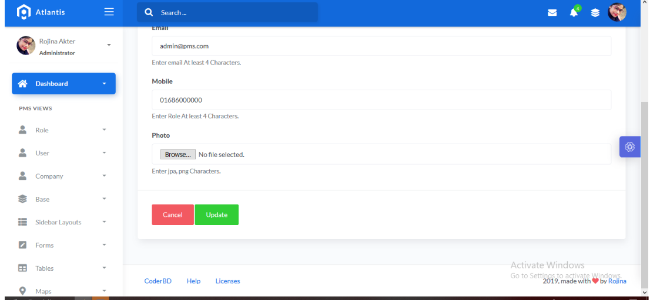
User Update

Slide 18
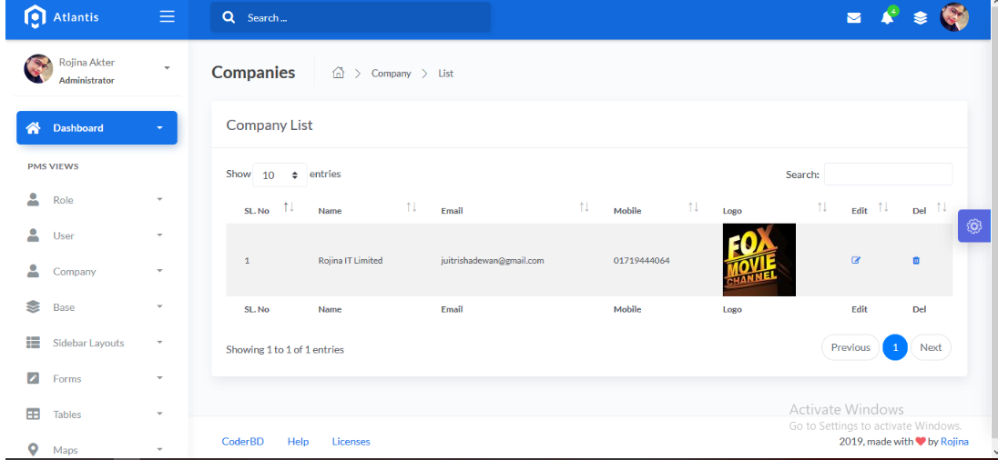
Company List

Slide 19
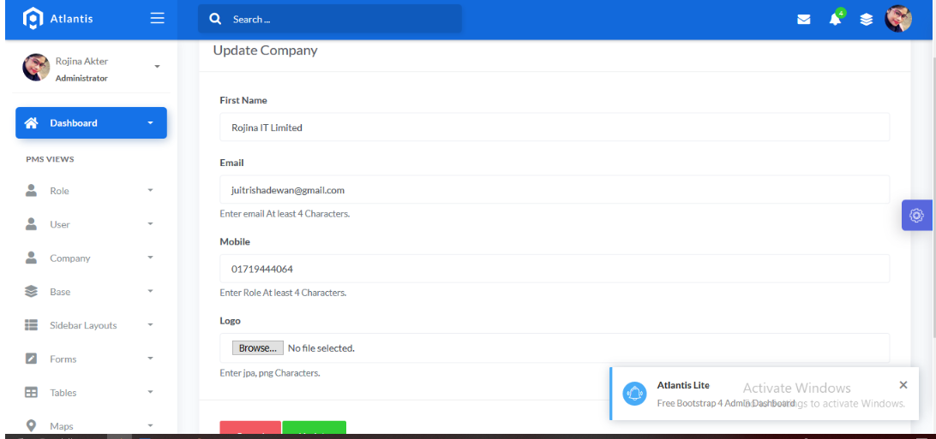
Company Update

Slide 20
End
Thank You Sir

